Slide 1

Unit-III
Energy sources
Electrochemistry

Slide 2
Batteries
The battery is a device consisting of one or more electrochemical cells connected with one another in a series that converts stored chemical energy into electrical energy.
Advantages of Batteries
Batteries can power devices anywhere without needing a direct power connection.
Store electrical energy for later use, which is vital for renewable sources like solar and wind.
Provide quick and stable electricity when needed, even during power failures.
Most modern batteries require little or no maintenance.
Rechargeable batteries reduce waste and pollution compared to disposable ones.
Unlike generators, batteries work quietly without noise or fumes.
Used in mobile phones, laptops, vehicles, medical equipment, and renewable energy systems.
High efficiency in converting chemical energy to electrical energy.
Battery systems can be scaled from small gadgets to large grid storage.
Serve as reliable backup power during outages.
$$\% of efficiency of battery=\frac{energy released on discharge}{energy required for charge}×100$$

Slide 3
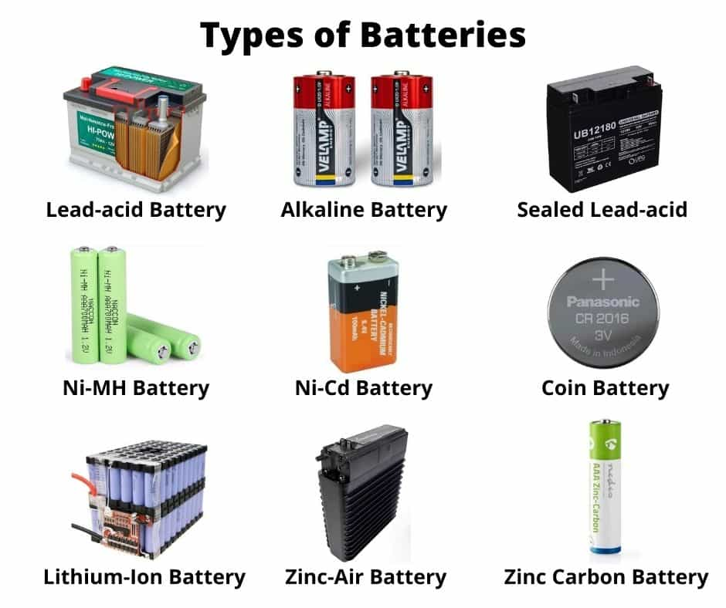
Classification of Batteries
I. Primary Battery / Cell: The battery in which the cell reaction is not reversible is called Primary Cell. Ex: Zinc-Air Battery.
Reserve battery: It is a type of primary (non-rechargeable) battery that is kept in an inactive state until it is needed, and then activated just before or during use. Ex: Lithium–Iron Disulfide Battery.
II. Secondary Battery / Cell): The battery in which the cell reactions are reversible is called Secondary Cell. Ex: Lithium Ion Cell.
III. Flow or Fuel Battery / Cell: It is an electro chemical cell that converts chemical energy into electrical energy, in which materials (reactants, products, electrolytes) pass through the battery. Ex: Methanol-Oxygen Fuel Cell.

Slide 4
Differences between Primary, Secondary and Fuel cells
Primary cell | Secondary cells | Fuel Cell
It acts as a simple galvanic cell. Cell reaction is not reversible. Cannot be recharged. Can be used as long as the materials are active in their composition. Examples are Leclanche or dry cell and Lithium cells. Applications: Radios, torches, transistors, hearing aids. | It acts as a galvanic cell while discharging and electrolytic cell while charging. Cell reaction can be reversed. Can be recharged Can be used again and again by recharging the cell. Examples are Lead storage cell, Lithium ion battery and Nickel cadmium battery. Applications: Electronic calculators, electronic flash units & cordless electronic shavers. | It acts as a simple galvanic cell. Cell reaction is not reversible. Do not store energy. Energy can be withdrawn indefinitely as long as outside supply of fuel. Examples are H₂-O₂ and CH₃OH-O_{2.}fuel cells Applications: Space vehicles.

Slide 5
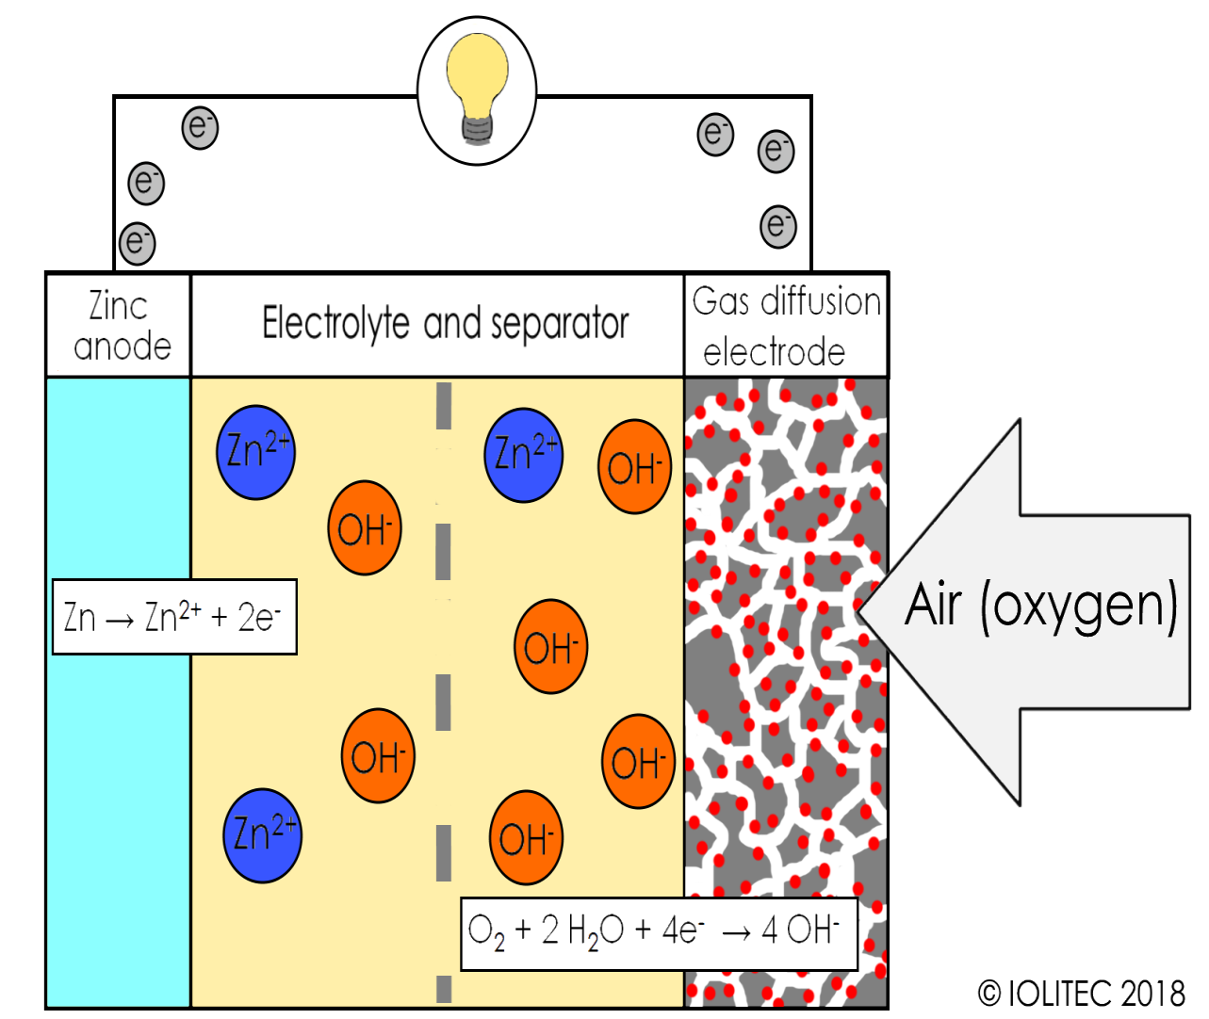
Zinc–Air Battery
A zinc–air battery is a type of electrochemical cell that generates electrical energy through the reaction between zinc metal and oxygen from the air.
It is classified as a primary battery in most commercial applications, though rechargeable variants exist.
COMPONENTS:
Anode: Zinc metal (powder).
Cathode: Porous carbon electrode with a catalyst (MnO₂, Pt or Co). This is a air electrode system. Allows oxygen from the atmosphere to diffuse into the cathode.
Electrolyte: Aqueous alkaline solution (KOH or NaOH).
Separator: Porous membrane that allows OH⁻ ions to pass but prevents electrode contact.

Slide 6
Principle: The Zn–Air Battery works on the principle of electrochemical redox reactions between zinc metal (oxidized at anode) and oxygen from air (reduced at cathode) in the presence of an alkaline electrolyte. Oxygen acts as the oxidizing agent, while zinc is the reducing agent.
Working mechanism: At the anode, Zinc is oxidized to Zn²⁺, which reacts with OH⁻ to form soluble zincate ions. Zincate later decomposes to zinc oxide. At the cathode, Oxygen from the air diffuses into the porous electrode and is reduced in alkaline medium to hydroxide ions.
Electrode Reactions
Anode (oxidation): Zn (s) + 4OH⁻ → [Zn(OH)₄]²⁻ + 2e⁻
[Zn(OH)₄]²⁻ → ZnO (s) + H₂O + 2OH⁻
Cathode (reduction): O₂ + 2H₂O + 4e⁻ → 4OH⁻
Overall cell reaction: 2Zn (s) + O₂ (g) → 2ZnO (s)

Slide 7
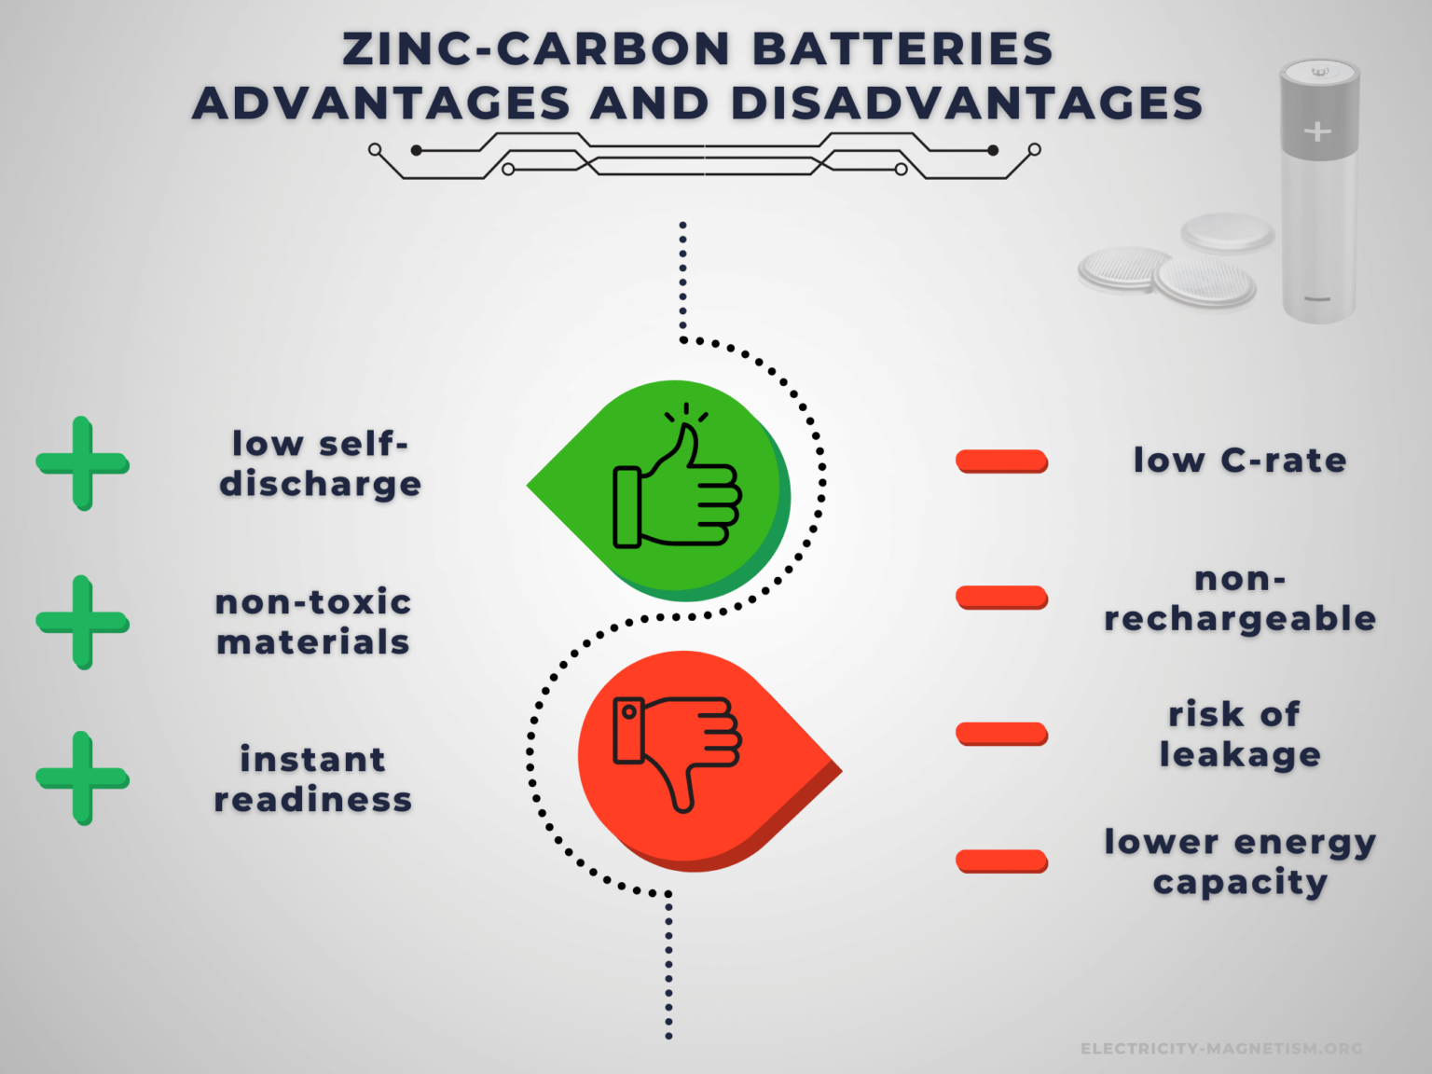
Applications
Hearing aids (button cells).
Medical devices (Pacemakers).
Electric vehicles (EVs).
Backup power systems.
Military communication devices.
Portable electronic equipment.

Slide 8
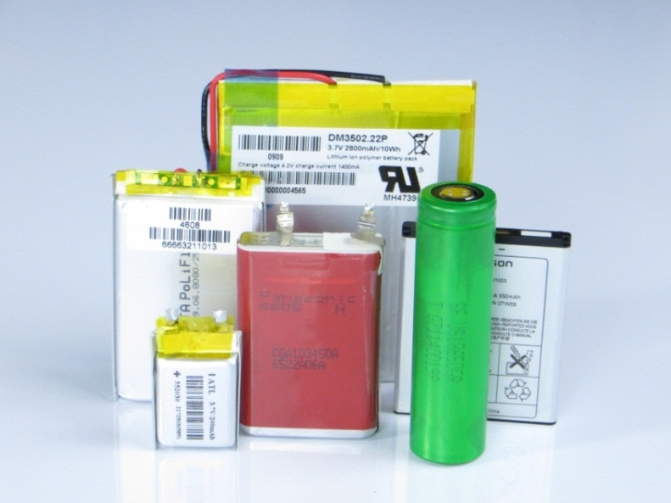
Lithium-ion battery
Lithium-ion (Li-ion) batteries are advanced rechargeable batteries that use lithium ions as the charge carriers.
They are widely used in portable electronic devices, electric vehicles, and energy storage systems due to their high energy density, light weight, and long cycle life.
Unlike primary batteries, Li-ion batteries can be recharged hundreds to thousands of times.
A Lithium ion battery is a type of rechargeable battery in which intercalated Li compounds are used as the electrode materials.
The cell reactions are reversible and works like Galvanic cell as well Electrolytic cell.

Slide 9
COMPONENTS OF LITHIUM-ION BATTERY:
Anode (Negative electrode): Usually made of graphite.
Cathode (Positive electrode): Typically made of lithium metal oxides such as LiCoO₂, LiFePO₄, LiMn₂O₄, or LiNiMnCoO₂.
Electrolyte: A lithium salt (LiPF₆, LiClO₄) dissolved in an organic solvent, which allows movement of Li⁺ ions.
Separator: A thin porous polymer membrane (polyethylene or polypropylene) that prevents contact between electrodes but allows ionic movement.
Current Collectors: Copper foil (anode) and Aluminum foil (cathode).
PRINCIPLE
The working principle of a Li-ion battery is based on the reversible intercalation and de-intercalation of lithium ions between the anode and cathode.
During charging, lithium ions move from the cathode to the anode and get stored in graphite layers.
During discharging, lithium ions move back to the cathode, releasing electrical energy.

Slide 10
WORKING MECHANISM
Charging process: An external power source supplies current. Lithium ions move from the cathode (LiCoO₂) through the electrolyte and get intercalated into the graphite anode. Electrons flow through the external circuit to balance charge. Cathode releases Li⁺ and electron, anode stores them.
At Cathode (LiCoO₂ ): LiCoO₂ → Li₁₋ₓCoO₂ + xLi⁺ + xe⁻
At Anode (Graphite): C₆ + Li⁺ + e⁻ → LiC₆
Discharging process: Lithium ions migrate back from the anode to the cathode. Electrons travel through the external circuit, providing electrical power to the connected device. The process is reversible, making the battery rechargeable.
At Anode (Graphite): LiC₆ → C₆ + Li⁺ + e⁻
At Cathode (LiCoO₂): Li₁₋ₓCoO₂ + xLi⁺ + xe⁻ → LiCoO₂

Slide 11
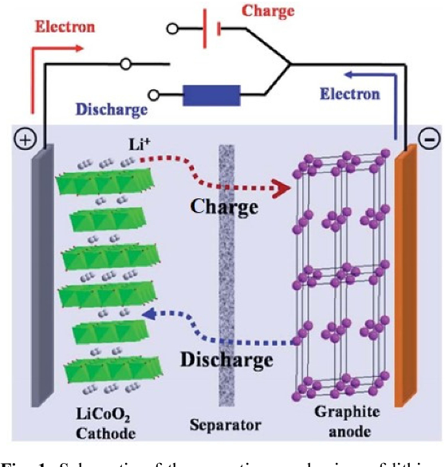
Applications
Mobile phones, laptops, tablets
Electric vehicles (EVs) and hybrid vehicles
Aerospace and defense
Power backup (UPS systems)
Medical devices (pacemakers, hearing aids)
Advantages
High energy density (smaller size)
Lightweight batteries
Low self-discharge rate
Long cycle life Environmentally friendlier
Limitations
High initial cost
Requires protection to avoid overcharging or discharging
Sensitive to high temperature
Performance decreases in very low temperatures
Recycling challenges due to toxic electrolytes and flammable organic solvents.

Slide 12
Fuel cells or Flow batteries
A fuel cell is an electrochemical cell, converts chemical energy of a fuel and oxidant into electrical energy.
The principle of fuel cell is same as that of the electro chemical cell, only difference is, the fuel and oxidant stored outside the cell.
These are also primary cells, but the electricity can be generated as long as the fuel and oxygen are supplied into the cell.
This cell consists of a liquid electrolyte sandwiched between the two porous electrodes.
Porous electrodes are used in fuel cells to provide a large surface area.
A catalyst such as Pt, Pd, Mg or Ni is often used to initiate and speed up the reactions.
There is no combustion involved. Oxidation of the hydrogen takes place electrochemically.
It is highly eco-friendly i.e. there is no harmful product.
Example: CH₃OH-O₂ Fuel cell.

Slide 13
Difference between Battery and Fuel Cell
Feature | Battery | Fuel Cell
Source of Energy | Stores chemical energy inside; limited by internal chemicals. | Generates electricity as long as external fuel and oxidant are supplied.
Reactants | Contained within the battery (closed system). | Continuously supplied from outside (open system).
Life Cycle | Discharges with use; rechargeable (secondary) or disposable (primary). | Operates continuously without recharging if fuel supply is maintained.
Efficiency | Efficiency decreases with repeated charge-discharge cycles. | High efficiency; consistent power output if fuel is pure.
Applications | Portable electronics, electric vehicles, backup power. | Spacecraft, submarines, electric vehicles, stationary power plants.
Environmental Aspect | Disposal/recycling may cause pollution (heavy metals, electrolytes). | Cleaner; hydrogen fuel cells produce only water and heat.

Slide 14
Methanol – Oxygen Fuel Cell
A Direct Methanol Fuel Cell (DMFC) is a type of proton exchange membrane fuel cell (PEMFC) where methanol (CH₃OH) is used directly as the fuel without prior reforming.
Carbon rods impregnated with Platinum are used as electrodes. Polymeric proton exchange membrane is used as electrolyte.
In fuel methanol and water supplied to the anode. The methanol molecule's carbon-hydrogen, and oxygen-hydrogen bonds are broken to generate electrons and protons.
Water molecule's oxygen-hydrogen bond is also broken to generate an electron and proton.
The carbon from the methanol and the oxygen from the water combine to form carbon dioxide.
Oxygen from air (supplied to the cathode) is simultaneously reduced at the cathode.
The positive ions (H⁺) are transferred across the proton exchange membrane to the cathode where they react with oxygen to produce water.
Electrons are transported through an external circuit from anode to cathode, providing power to a connected device.

Slide 15
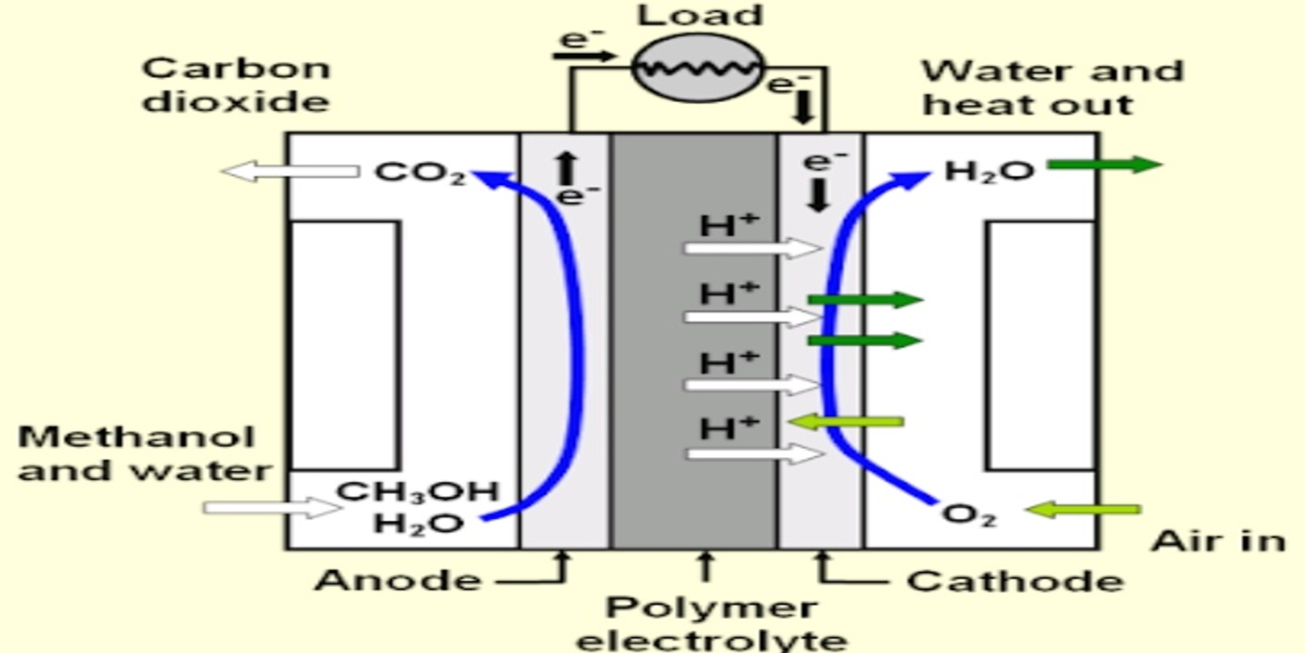
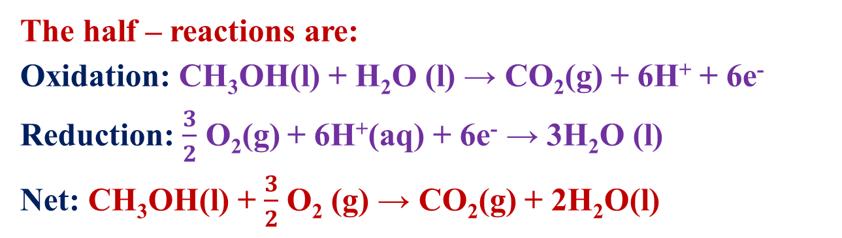
The half – reactions are:
Oxidation: CH₃OH(l) + H₂O (l) → CO₂(g) + 6H⁺ + 6e⁻
Reduction: $\frac{3}{2}$ O₂(g) + 6H⁺(aq) + 6e⁻ → 3H₂O (l)
Net: CH₃OH(l) + $\frac{3}{2}$ O₂ (g) → CO₂(g) + 2H₂O(l)
Applications of DMFC
1. Portable Power Sources – mobile phones, laptops, tablets, and cameras.
2. Military Applications – lightweight power packs for soldiers in remote areas.
3. Transportation – potential use in automobiles, buses, and drones.
4. Backup Power – emergency systems, remote sensors, and telecommunications.
5. Consumer Electronics – disposable methanol cartridges for recharging devices.

Slide 16
Advantages and Disadvantages of Fuel Battery
Advantages:
High Efficiency- when utilizing co-generation, fuel cells can attain over 80% energy efficiency.
Good reliability- quality of power provided does not degrade over time.
Noise- offers a much more silent and smoother alternative to conventional energy production.
Environmentally beneficial- greatly reduces CO₂ and harmful pollutant emissions.
Size reduction- fuel cells are significantly lighter and more compact.
Disadvantages:
Expensive to manufacture due the high cost of catalysts (platinum).
Lack of infrastructure to support the distribution of hydrogen.
The currently available fuel cell technology is in the prototype stage and not yet validated.
Hydrogen is expensive to produce and not widely available.

Slide 17
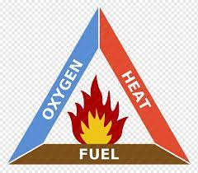
Introduction to Fuels
Fuels are substances that produce usable energy when burned or consumed through chemical or nuclear reactions.
The primary function of a fuel is to provide energy in the form of heat or power, which can be converted into mechanical work and electricity.
Fuels can be broadly classified into Natural fuels (such as Wood, Coal, Petroleum, and Natural gas) and Synthetic fuels (such as Hydrogen, Producer gas, and Biofuels).
Based on their physical state, they are categorized as Solid fuels (Coal, Coke, Wood), Liquid fuels (Petrol, Diesel, Kerosene), and Gaseous fuels (LPG, CNG, Hydrogen, biogas).

Slide 18
Characteristics of a Good Fuel
High Calorific Value: It should produce a large amount of heat per unit mass or volume.
Moderate Ignition Temperature: The fuel should ignite easily but not so low that it catches fire accidentally.
Controlled Combustion: It should burn smoothly and steadily without explosions or harmful byproducts.
Availability and Cost: It must be easily available in nature and economical to use.
Ease of Transportation and Storage: It should be easy and safe to store, handle, and transport.
Low Moisture and Non-combustible Matter: Less water and ash content give higher efficiency.
Minimal Pollution: It should release fewer harmful gases (SO₂, CO, NO_{x}, smoke) during combustion.
High Density: A compact, energy-rich fuel is preferable for storage and transport.
Non-toxic and safe: It should not pose serious health hazards or risks of explosion under normal conditions.
Residue after Combustion: A good fuel should leave very little ash or other solid residues.

Slide 19
Calorific Value (CV)
The calorific value of a fuel is the amount of heat energy produced when one unit mass of the fuel is completely burnt in oxygen. It is expressed in two ways.
Higher Calorific Value (HCV) / Gross Calorific Value (GCV): It is the total heat liberated when fuel is completely burnt and the products of combustion are cooled to room temperature, so that the latent heat of condensation of water vapor is also included.
Ex: If hydrogen is burnt, the water vapor formed condenses and releases latent heat, which is counted in HCV.
II. Lower Calorific Value (LCV) / Net Calorific Value (NCV): It is the heat produced when fuel is completely burnt but the products are not cooled, hence the latent heat of vaporization of water vapor is not recovered.
LCV = HCV – Mass of water X Latent heat of vaporization of steam.

Slide 20
Units of Calorific Value
Calorie: It is the amount of heat required to raise the temperature of 1 gram of water through one degree centigrade.
2. British Thermal Unit (BTU): It is the amount of heat required to raise the temperature of 1 pond of water to one degree Fahrenheit.
3. Centigrade Heat Unit (CHU): It is define as the amount of heat required to raise the temperature of 1 pond of water to one degree centigrade.
SI Units (preferred)
Joules per kilogram (J/kg) → for solid and liquid fuels
Joules per cubic meter (J/m³) → for gaseous fuels
CGS Unit (older system)
calorie per gram (cal/g)
kilocalorie per kilogram (kcal/kg)
kilocalorie per cubic meter (kcal/m³)
Conversion Factors
1 cal = 4.184 J
1 kcal/kg = 4.184 kJ/g = 4184 J/g = 4184 kJ/kg
1 BTU = 1055 J
1 kcal = 3.968 BTU

Slide 21
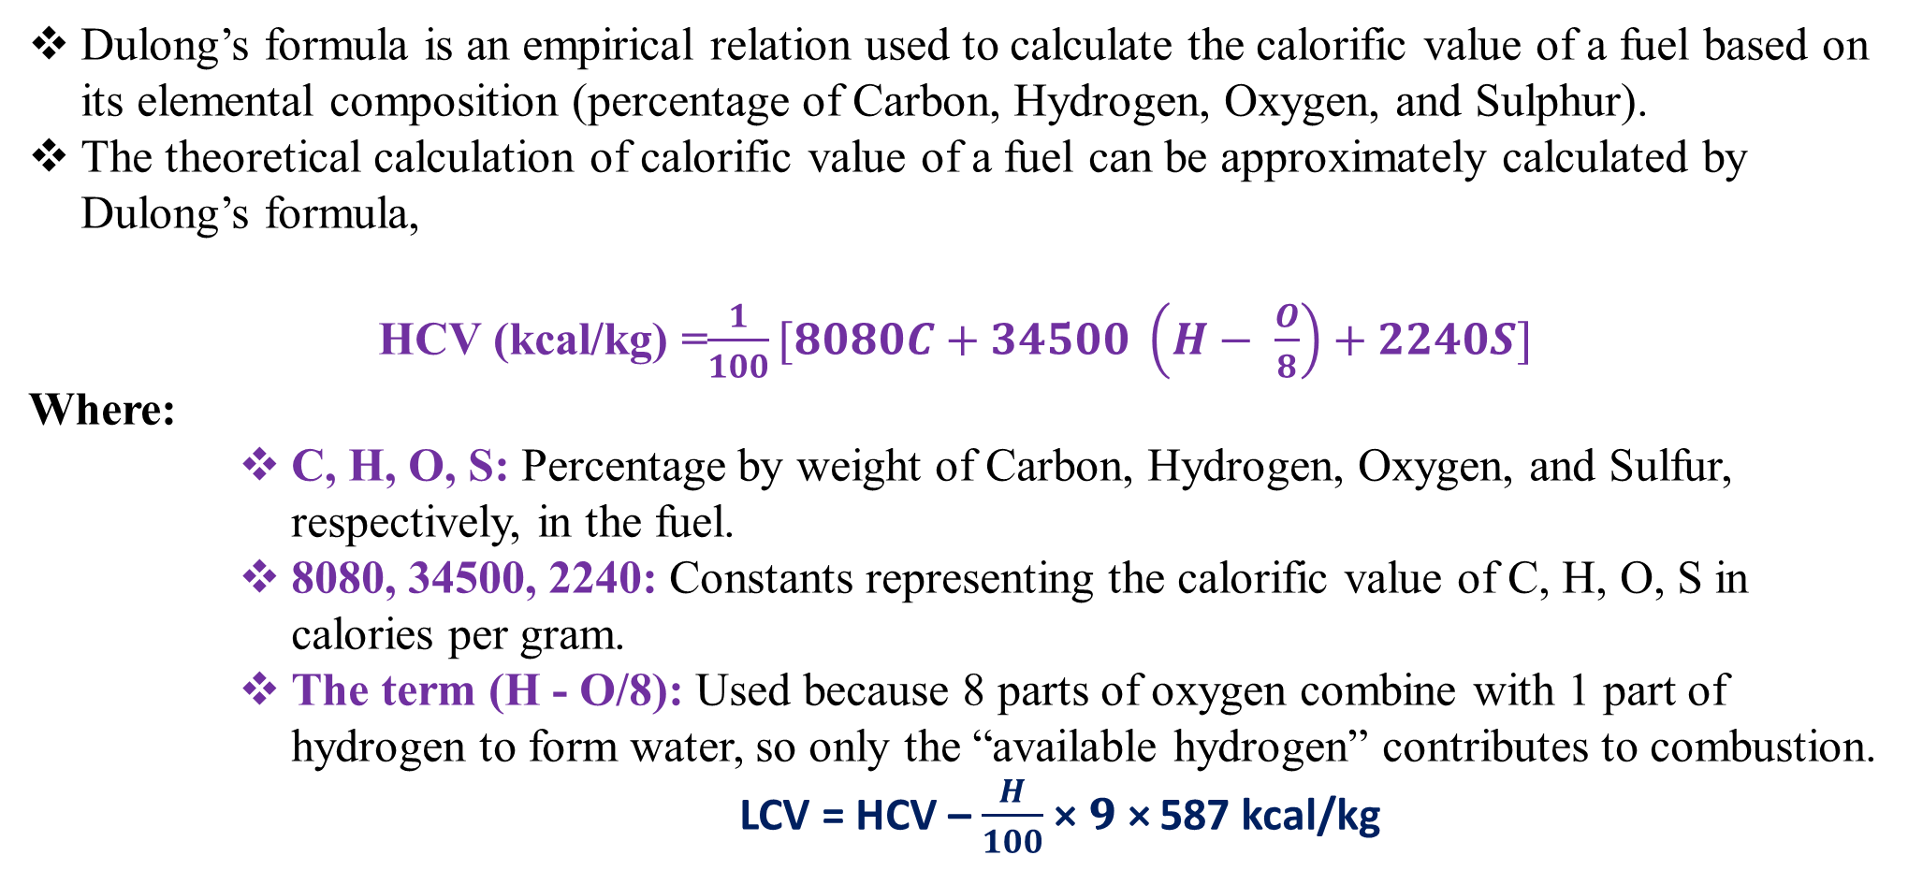
Dulong’s Formula
Dulong’s formula is an empirical relation used to calculate the calorific value of a fuel based on its elemental composition (percentage of Carbon, Hydrogen, Oxygen, and Sulphur).
The theoretical calculation of calorific value of a fuel can be approximately calculated by Dulong’s formula,
HCV (kcal/kg) =$\frac{1}{100}[8080C+34500 \left(H− \frac{O}{8}\right)+2240S]$
Where:
C, H, O, S: Percentage by weight of Carbon, Hydrogen, Oxygen, and Sulfur, respectively, in the fuel.
8080, 34500, 2240: Constants representing the calorific value of C, H, O, S in calories per gram.
The term (H - O/8): Used because 8 parts of oxygen combine with 1 part of hydrogen to form water, so only the “available hydrogen” contributes to combustion.
LCV = HCV – $\frac{H}{100}$ × 𝟗 × 587 kcal/kg

Slide 22
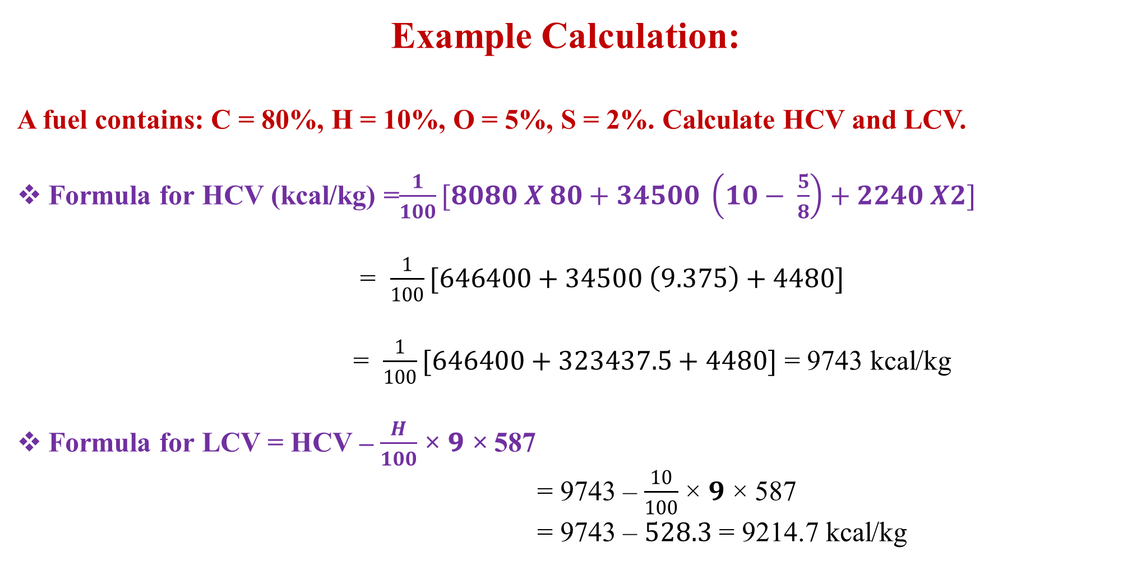
Example Calculation:
A fuel contains: C = 80%, H = 10%, O = 5%, S = 2%. Calculate HCV and LCV.
Formula for HCV (kcal/kg) =$\frac{1}{100}[8080 X 80+34500 \left(10− \frac{5}{8}\right)+2240 X2]$
= $\frac{1}{100}[646400+34500 \left(9.375\right)+4480]$
= $\frac{1}{100}[646400+323437.5+4480]$ = 9743 kcal/kg
Formula for LCV = HCV – $\frac{H}{100}$ × 𝟗 × 587
= 9743 – $\frac{10}{100}$ × 𝟗 × 587
= 9743 – $528.3$ = 9214.7 kcal/kg

Slide 23
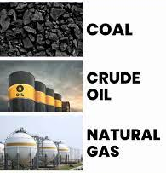
Fossil Fuels
Fossil fuels are natural energy resources formed from the decomposition of ancient plants and animals buried deep under the earth’s crust for millions of years.
Under high temperature and pressure, these organic materials undergo chemical and physical transformations, resulting in carbon-rich fuels such as coal, petroleum, and natural gas.
They are the primary source of energy for industrial, domestic, and transport purposes, contributing to over 80% of the world’s energy demand.
However, their usage leads to air pollution, greenhouse gas emissions, and global warming.
Based on renewability fossil fuels are non-renewable, finite resources and can be replenished.

Slide 24
Classification of Fossil Fuels
Fossil fuels can be classified in several ways:
Based on Physical State
Solid: Coal, lignite, peat
Liquid: Petroleum (crude oil, diesel, kerosene, petrol)
Gaseous: Natural gas, coal gas, oil gas, shale gas
II. Based on Origin
Terrestrial origin: Derived mainly from land plants (coal).
Marine origin: Derived mainly from marine organisms (petroleum, natural gas).
III. Based on Carbon Content (Coal types)
Peat (lowest carbon, high moisture, low calorific value)
Lignite (brown coal, moderate carbon, higher moisture)
Bituminous coal (most common, high carbon, used in industries)
Anthracite (highest carbon, hardest, highest calorific value)

Slide 25
Cracking
Cracking is the process of breaking down large hydrocarbon molecules (high molecular weight) into smaller, more useful molecules (low molecular weight) such as gasoline, diesel, and olefins.
Cracking is a vital process in the petroleum industry for several reasons
It is a key process in petroleum refining to improve the yield of valuable fuels.
I. Producing Fuels: It converts heavy, less desirable fractions of crude oil into lighter, more useful fuels like gasoline, diesel, and jet fuel.
II. Creating Petrochemical Feedstock: Cracking produces alkenes (like ethylene and propylene) which are essential building blocks for plastics and other chemicals.
III. Meeting Market Demands: By adjusting the cracking process, refiners can tailor the product mix to meet the specific demands of the market.

Slide 26
Process of Cracking
The chemical process of cracking involves various free radical reactions.
A. Initiation: Free radicals are important for the process of cracking. One molecule is broken down into two free radicals, in which the smaller portion undergoes initiation.
CH₃CH₃ → 2 CH₃•
B. Hydrogen Abstraction: Hydrogen is removed from the second molecule; hence it becomes a free radical as shown.
CH₃• + CH₃CH₃ → CH₄ + CH₃CH₂•
C. Radical Decomposition: Free radicals break into other free radical to produce alkene products.
CH₃CH₂• → CH₂=CH₂ + H•
D. Radical Addition: Free radicals react with alkene and produce free radicals which form aromatic products.
CH₃CH₂• + CH₂=CH₂ → CH₃CH₂CH₂CH₂•
E. Termination: The termination process happens when two radicals react with each other to form a non-free radical product resulting in recombination and disproportionation.
CH₃• + CH₃CH₂• → CH₃CH₂CH₃
CH₃CH₂• + CH₃CH₂• → CH₂=CH₂ + CH₃CH₃

Slide 27
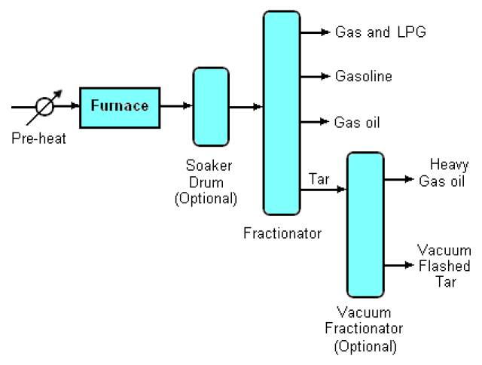
Types of Cracking
Cracking can be broadly classified into Thermal Cracking and Catalytic Cracking:
I. Thermal Cracking:
Decomposition of heavy hydrocarbons into smaller molecules by heating at high temperature and pressure
Conditions: Temperature range 450–750 °C, pressure 70–7000 kPa.
Products: Alkenes (ethylene, propylene, butylene) and some gasoline.
Types:
Liquid Phase Thermal Cracking: High pressure, moderate temperature; produces gasoline.
Vapor Phase Thermal Cracking: High temperature, lower pressure; produces olefins and light oils.

Slide 28
II. Catalytic Cracking
In this method, breaking down of hydrocarbons in the presence of a catalyst (zeolites, alumino- silicates) at lower temperatures than thermal cracking.
Moving Bed Catalytic Cracking (MBCC)
Moving Bed Catalytic Cracking (MBCC) is a process used in petroleum refineries to convert heavy hydrocarbon fractions (like vacuum gas oil) into more valuable lighter products such as gasoline, LPG, olefins, and middle distillates.
Principle of Moving Bed Catalytic Cracking:
The process is based on catalytic cracking, where high-molecular-weight hydrocarbons are broken down into smaller hydrocarbons in the presence of a solid acid catalyst (commonly zeolites).
In MBCC, the catalyst is in the form of small pellets or beads that move downwards by gravity through the reactor and regenerator.
This movement allows continuous catalyst circulation, maintaining high activity and preventing deactivation due to coke deposits.

Slide 29
Process Description:
Feed Introduction: The heavy hydrocarbon feed (gas oil, vacuum gas oil, etc.) is preheated and fed into the reactor.
Cracking Reaction: The feed contacts the moving bed of hot catalyst (typically 500–550 °C). Large hydrocarbon molecules crack into smaller ones like gasoline (C5–C12), LPG (C3–C4), olefins, and cycle oils. Coke is simultaneously deposited on the catalyst surface, deactivating it.
Catalyst Withdrawal: The coked catalyst is withdrawn from the reactor bottom. Fresh or regenerated catalyst enters the top, ensuring continuous movement.
Regeneration: The coked catalyst is transported to a regenerator. Coke is burned off in the presence of air, restoring the catalyst’s activity. The regenerated hot catalyst is then recycled back to the reactor.

Slide 30
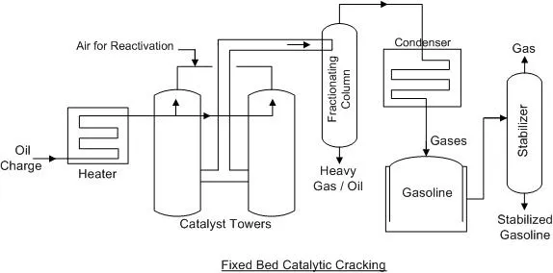
Advantages of MBCC:
Continuous operation with steady catalyst activity.
Simpler mechanical design.
Lower catalyst attrition
Good control of residence time of catalyst and feed

Slide 31
Comparison of LPG and CNG
Feature | LPG (Liquefied Petroleum Gas) | CNG (Compressed Natural Gas)
Composition | Propane (C₃H₈) and Butane (C₄H₁₀) | Methane (CH₄) (85–95%)
Storage | Stored as a liquid under moderate pressure. | Stored as a gas under high pressure
Calorific Value | ~46–50 MJ/kg (higher) | ~48 MJ/kg (lower )
Density | Heavier than air (settles down in case of leakage) | Lighter than air (disperses quickly if leaked)
Odour | Odorized with mercaptans for detection | Odorized with mercaptans for detection
Uses | Cooking, heating, industrial applications, auto LPG, petrochemical feedstock | Fuel for vehicles (cars, buses, autos), power generation, domestic PNG supply
Transportation | Supplied in cylinders (domestic & commercial) | Supplied through pipelines or in high-pressure cylinders
Safety | More prone to accidents due to heavier-than-air nature | Safer, as it disperses quickly in air
Environmental Impact | Cleaner than coal/diesel, but higher CO₂ and hydrocarbons than CNG | Eco-friendlier, very low CO₂, NOx, SOx, and particulate emissions

Slide 32
Synthetic Fuels
Synthetic fuels are man-made alternatives to conventional fossil fuels, produced from non-petroleum sources such as natural gas, coal, biomass, or renewable electricity.
They are developed to reduce dependence on crude oil, lower greenhouse gas emissions, and provide cleaner energy solutions for transportation, power generation, and industrial use.
Two important synthetic fuels gaining attention are Hythane and Green Hydrogen.
Significance:
Synthetic fuels offer a pathway to decarbonize sectors that are difficult to electrify directly, such as heavy transportation and certain industrial processes.
They can be produced from renewable energy sources and captured CO2, contributing to a circular economy and mitigating climate change.
The development and deployment of synthetic fuel technologies are crucial for achieving global climate goals and transitioning to a sustainable energy system

Slide 33
Hythane
Hythane is a blended synthetic fuel consisting of natural gas (80–90%) mixed with hydrogen (10–20%).
It combines the benefits of hydrogen (clean burning, reduced emissions) with natural gas (readily available, cost-effective, existing infrastructure).
The blending improves combustion efficiency and reduces harmful emissions like CO, CO₂, NOₓ, and particulates.
Applications
Transportation – Used as a cleaner fuel for buses, trucks, and fleet vehicles, particularly in urban areas.
Power Generation – Employed in gas turbines and engines for electricity production with lower emissions.
Industrial Heating – Provides an efficient and cleaner substitute for natural gas in furnaces and boilers.
Transition Fuel – Acts as a bridge between natural gas and pure hydrogen economy, utilizing existing CNG infrastructure.

Slide 34
Green Hydrogen
Green Hydrogen is hydrogen produced through electrolysis of water using renewable energy (solar, wind, hydro).
Unlike grey or blue hydrogen (derived from fossil fuels), green hydrogen is 100% carbon-free, making it a crucial fuel for sustainable development.
It can be stored, transported, and used as a clean energy carrier.
Applications
Transportation (Fuel Cells) – Powers fuel cell electric vehicles (FCEVs) such as cars, buses, trains, and even aircraft.
Power Generation & Storage – Acts as a long-term energy storage medium, balancing intermittent renewable energy sources.
Industrial Applications – Used in steel, cement, fertilizer (ammonia), and chemical industries as a clean alternative to coal or natural gas.
Residential & Commercial Use – Potential substitute for LPG and natural gas in heating and cooking.
Export Commodity – Countries with surplus renewable energy can export green hydrogen as an energy carrier.

Slide 35
SHORT ANSWER QUESTIONS
Define a primary battery with one example.
Write the composition of LPG.
State the unit of calorific value.
What are fossil fuels?
Mention one application of a lithium-ion battery.
Differentiate between HCV and LCV of a fuel.
Why is cracking necessary in the petroleum industry?
Describe the characteristics of a good fuel.
Explain why hydrogen is called a clean fuel.
Identify which fuel (CNG or LPG) is more suitable for automobiles and justify.
Construct a comparison table of primary and secondary batteries (any two points).
Show by example how synthetic fuels reduce greenhouse gas emissions.
Compare a battery and a fuel cell (any two differences).
Analyze the role of catalysts in moving bed catalytic cracking.
Compare applications of Hythane and Green Hydrogen.
Justify the need for synthetic fuels in present-day energy systems.
Evaluate the environmental impact of using CNG instead of LPG.
Formulate two key advantages of using Hythane in public transport.
Suggest an innovative application of Zn-air batteries in the medical field.

Slide 36
EASSAY QUESTIONS
Write short notes on primary, secondary and reserve batteries with suitable examples.
List and explain the characteristics of a good fuel.
Explain the construction, working, and applications of a Zn-air battery with a neat diagram.
Explain the construction, working, and applications of a Lithium-ion battery with a neat diagram.
Differentiate between High Calorific Value (HCV) and Low Calorific Value (LCV) with examples.
Apply Dulong’s formula to calculate the calorific value of a coal sample containing: C = 80%, H = 6%, O = 8%, S = 1%, N = 1%, Ash = 4%.
Construct a comparative account of Lithium-ion and Zn-air batteries in terms of construction, working, and applications.
Analyze the differences between a fuel cell and a battery in terms of energy source, efficiency, and applications.
Discuss the role of catalysts in moving bed catalytic cracking with a schematic representation.
Evaluate the advantages and disadvantages of CNG vs LPG as automobile fuels.
Justify the importance of synthetic fuels in achieving sustainable energy goals.
Design a chart for the classification of fossil fuels with examples.
Propose Direct Methanol Fuel Cell (DMFC).

